Slide 1
Flipping Your Classroom with MyLab Math and Interactive Statistics
George Woodbury
College of the Sequoias
Visalia, CA

Slide 2
Quiz
Do your students come to class prepared for that day’s work?
Do you want your classroom to be an active space for rich and engaging learning?

Slide 3

Flipped Learning is for You!
Source: vivendoavidabemfeliz.blogspot.com

Slide 4

Misconceptions About Flipped Learning

Slide 5
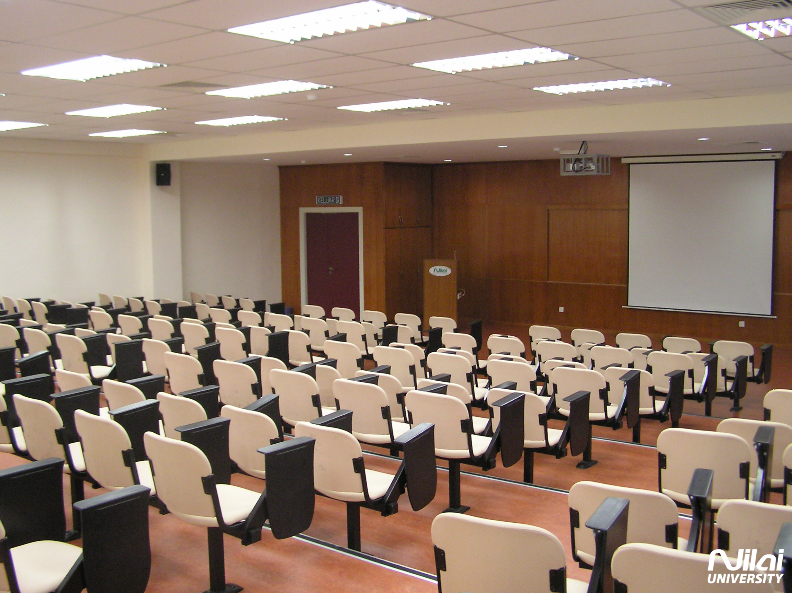
What IS Flipped Learning?
Source: Eduspiral.com

Slide 6
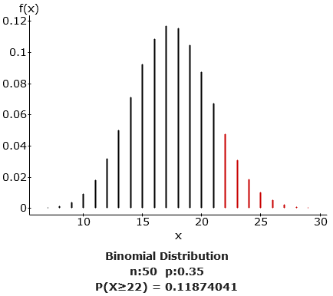
How I Did It – Introductory Statistics

Slide 7
How I Did It – Introductory Statistics
Pre-Class
Students complete an Interactive Reading Assignment before class.
These assignments are from Interactive Statistics by Mike Sullivan and myself.
These assignments are a mixture of text, video, and problems.

Slide 8
How I Did It – Introductory Statistics
In-Class
Use a Student Response System (SRS) for Peer Instruction.
Use Immediate Feedback Assessment Technique (IF-AT).
Give collaborative assignments that go over the material covered before class as well as extend knowledge to new tasks.
Use projects that require students to use data they collected to build upon their previous knowledge.

Slide 9
How I Did It – Introductory Statistics
Post-Class
Students complete a short, “standard” homework assignment based on the section we worked on.
Some assignments are turned in online and others are turned in by hand.

Slide 10
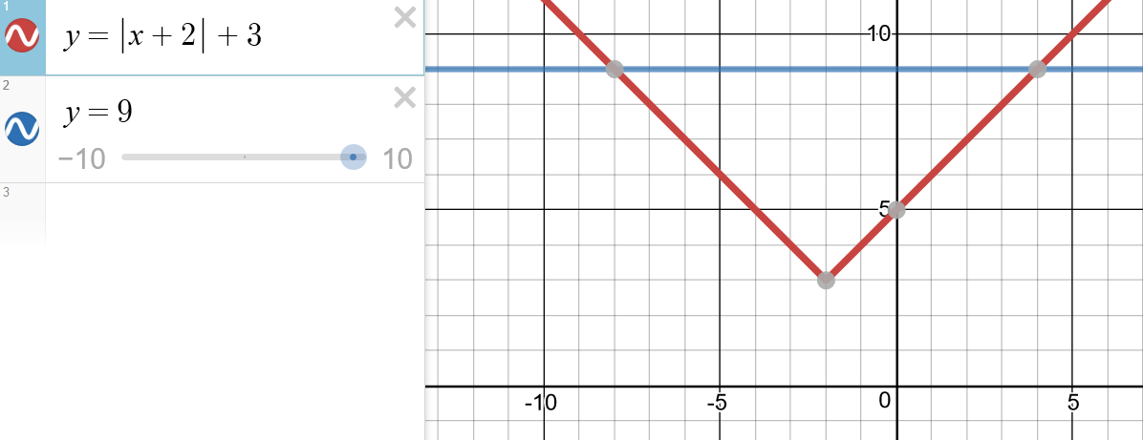
How I Did It – Elementary & Intermediate Algebra

Slide 11
How I Did It – Elementary & Intermediate Algebra
Pre-Class
Students complete a MyLab assignment before class.
Mixture of conceptual videos, example videos, and problems.

Slide 12
How I Did It – Elementary & Intermediate Algebra
In-Class
Give group assignments that go over material from pre-class assignment.
Use interactive mini-lectures to introduce new topics.
Give group assignments to solidify/extend understanding of new topics.

Slide 13
How I Did It – Elementary & Intermediate Algebra
Post-Class
Students take a short (5-question) quiz.
The quiz loads a personalized homework assignment based on problems from the quiz that require more practice.
After completing the personalized homework assignment, students can retake the quiz.

Slide 14
How I Did It – Online Algebra
I now use the same 3 assignment cycle (FLIP Assignment, Reflect Quiz, Personalized Homework) for each section covered in my online algebra classes.

Slide 15
Your Turn
Form a group and pick a topic to flip from a course that you all teach.
List the objectives for that topic, listing them from most accessible/least complex to least accessible/most complex.
Draw a line between the direct instruction that will be handled outside of class and the material where students need your guidance.

Slide 16

Recommendations for You
Source: Conrad Bakker (Flickr)

Slide 17

Recommendations for You
Source: Mozilla

Slide 18

Recommendations for You
Source: Socialbrite

Slide 19
Recommended Reading/Viewing
Flipped Learning: A Guide for Higher Education Faculty by Robert Talbert
Teaching with Classroom Response Systems by Derek Bruff
Peer Instruction Videos (YouTube) by Eric Mazur

Slide 20

Source: jaime-dulceguerrero.com

Slide 21
Read All About It!
Presentation & Summary: georgewoodbury.com/AMATYC2017
Blog: georgewoodbury.com/statblog/
Flip Site: georgewoodbury.com/flip/

Slide 22
Contact Information
Email: georgew@cos.edu
Twitter: @georgewoodbury
Website: georgewoodbury.com

